Slide 1

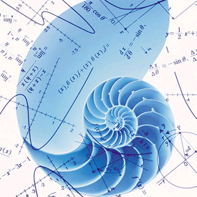
Azərbaycan Dövlət Neft və Sənaye Universiteti
Numerical Methods I

Slide 2
Introduction to
Numerical Methods

Slide 3
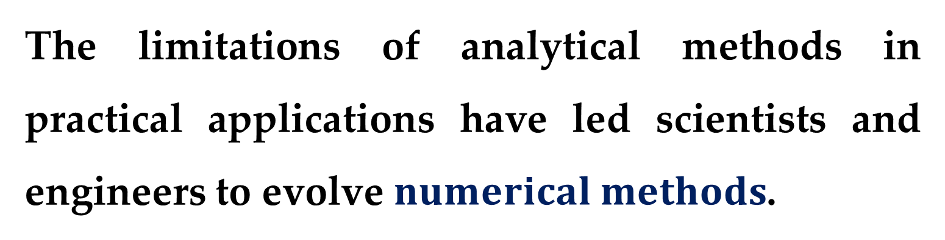
The limitations of analytical methods in practical applications have led scientists and engineers to evolve $numerical methods$.
It is well known that exact methods often fail in drawing plausible inferences from a given set of tabulated data or in finding roots of transcendental equations or in solving non-linear differential equations.

Slide 4
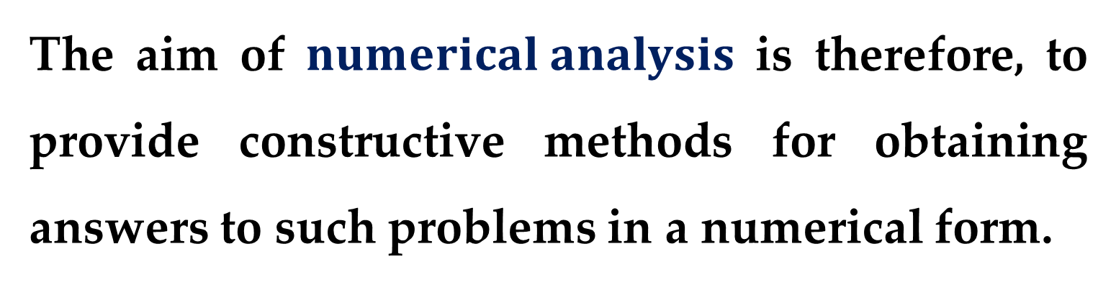
There are many more such situations where analytical methods are unable to produce desirable results.
Even if analytical solutions are available, these are not amenable to direct numerical interpretation.
The aim of $numerical analysis$ is therefore, to provide constructive methods for obtaining answers to such problems in a numerical form.

Slide 5
With the advent of high speed computers and increasing demand for numerical solution to various problems, numerical techniques have become indispensable tools in the hands of engineers and scientists.
The widespread availability of computers (especially personal computers) has had a significant influence on the actual scientific and engineering problem-solving process.

Slide 6
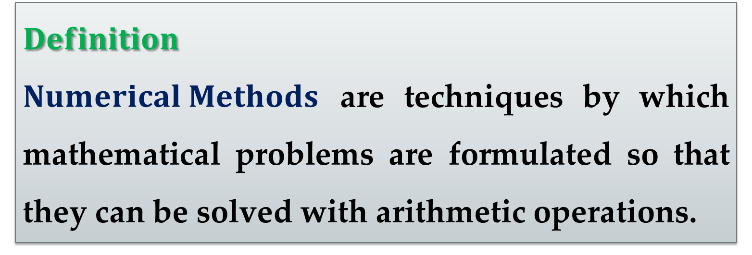
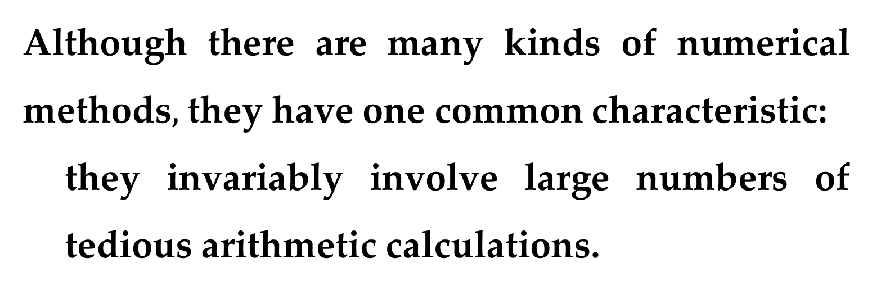
$$Definition$$
$Numerical Methods$ are techniques by which mathematical problems are formulated so that they can be solved with arithmetic operations.
Although there are many kinds of numerical methods$,$ they have one common characteristic:
they invariably involve large numbers of tedious arithmetic calculations.

Slide 7
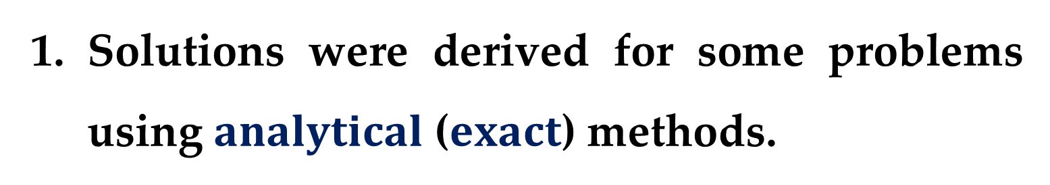
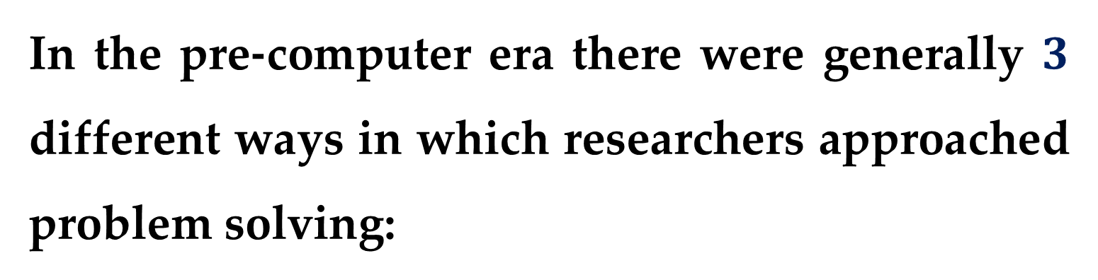
In the pre-computer era there were generally $3$ different ways in which researchers approached problem solving:
Solutions were derived for some problems using $analytical$ ($exact$) methods.
These solutions were often useful and provided insight into the behavior of some systems.

Slide 8
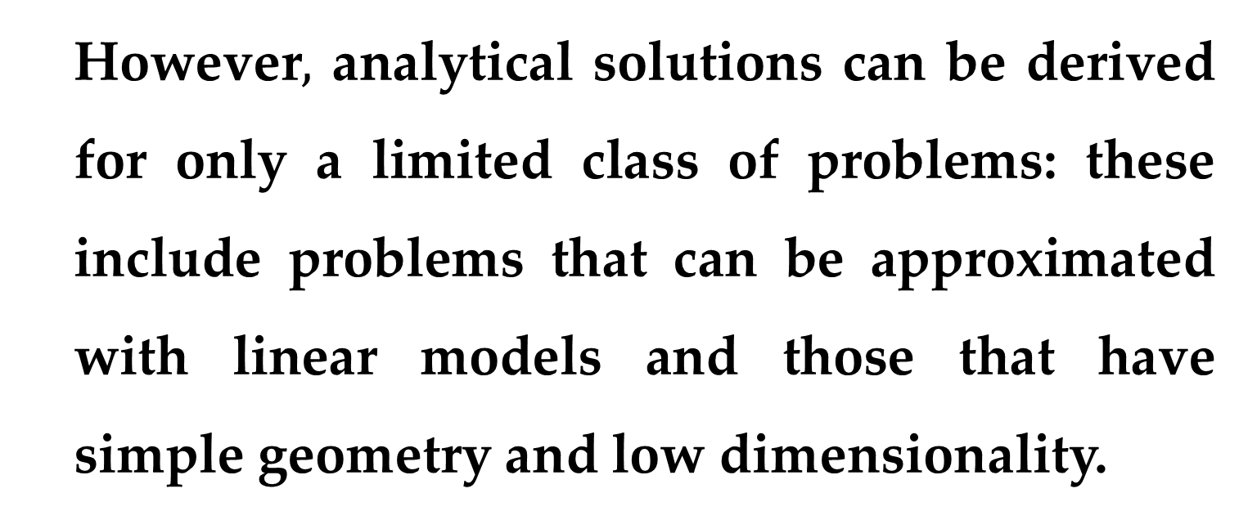
However$,$ analytical solutions can be derived for only a limited class of problems: these include problems that can be approximated with linear models and those that have simple geometry and low dimensionality.
Consequently, analytical solutions are of limited practical value because most real problems are nonlinear and involve complex shapes and processes.

Slide 9
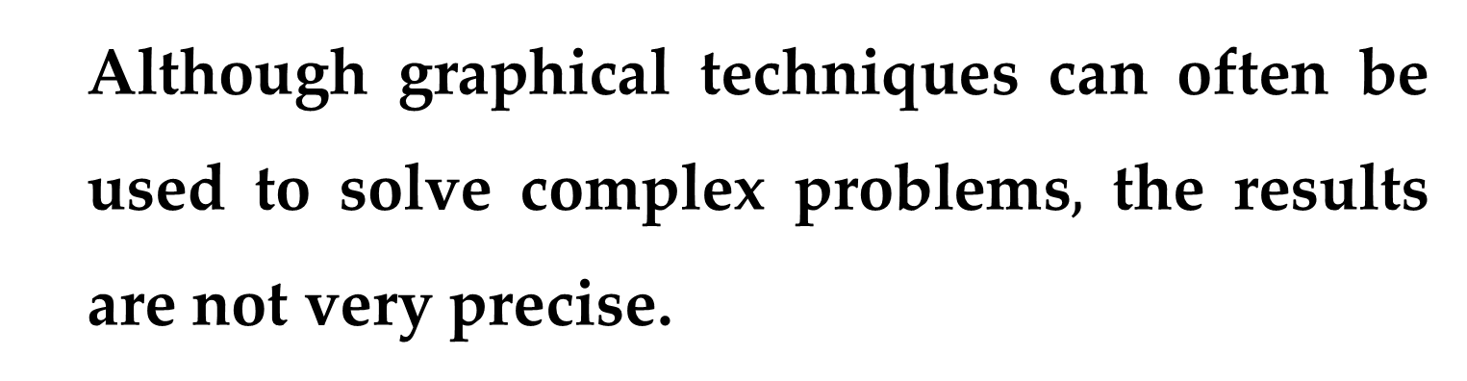
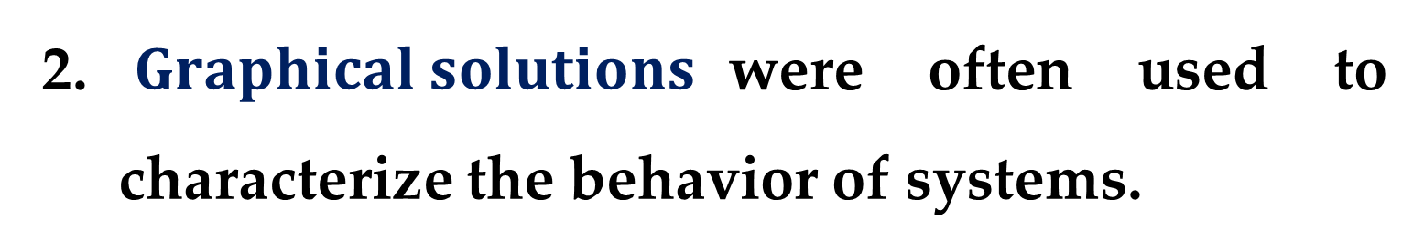
$Graphical solutions$were often used to characterize the behavior of systems.
These graphical solutions usually took the form of plots.
Although graphical techniques can often be used to solve complex problems$,$ the results are not very precise.

Slide 10
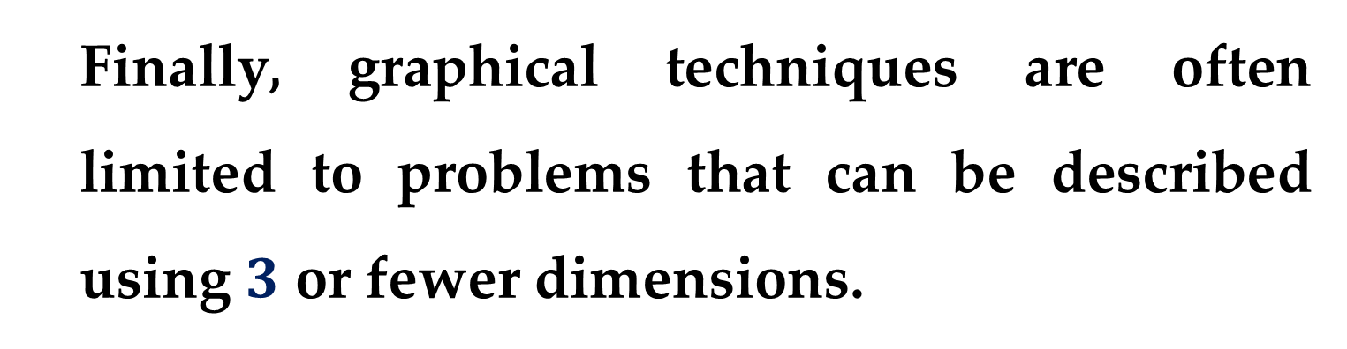
Furthermore, graphical solutions (without the aid of computers) are extremely tedious and awkward to implement.
Finally, graphical techniques are often limited to problems that can be described using $3$ or fewer dimensions.

Slide 11
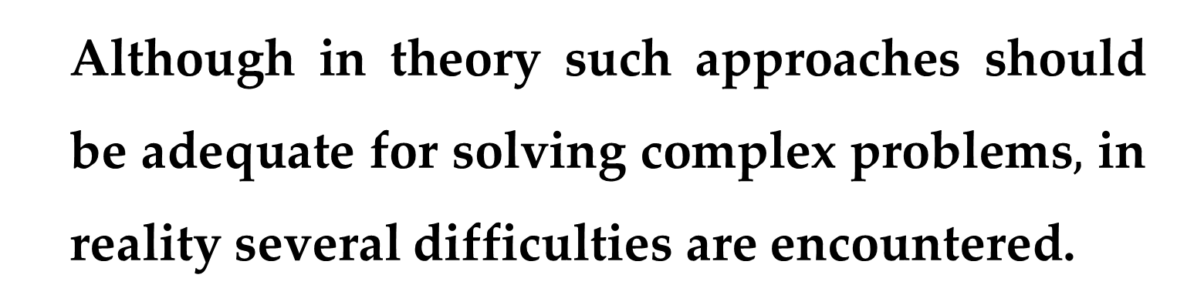
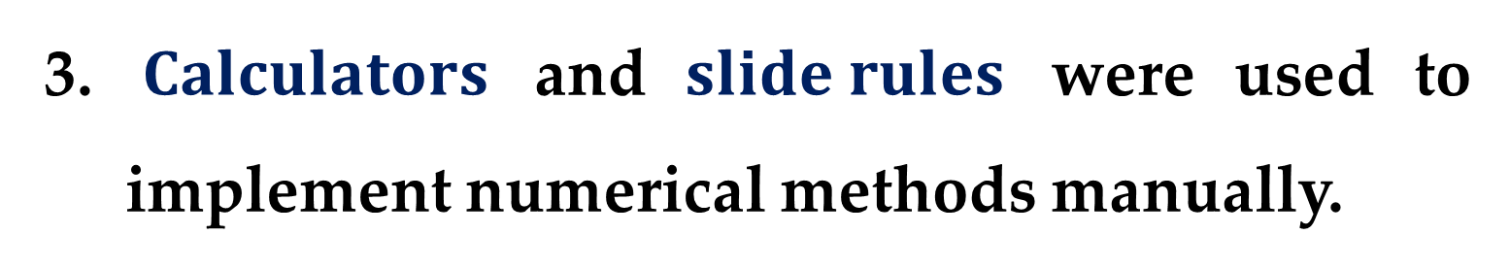
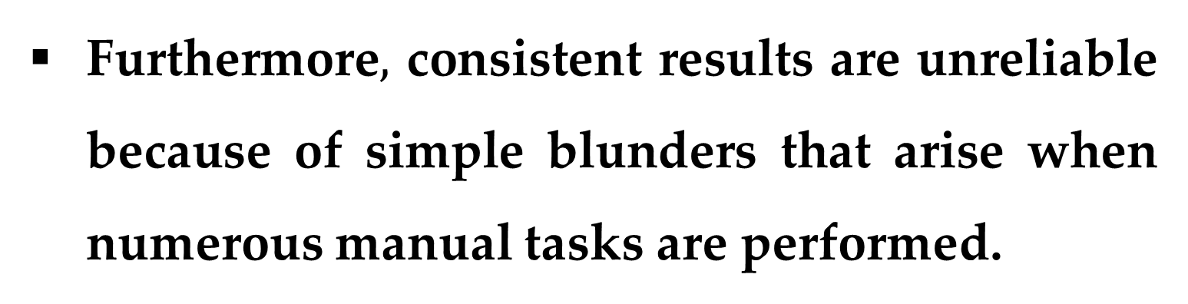
$Calculators$ and $slide rules$ were used to implement numerical methods manually.
Although in theory such approaches should be adequate for solving complex problems$,$ in reality several difficulties are encountered.
Manual calculations are slow and tedious.
Furthermore$,$ consistent results are unreliable because of simple blunders that arise when numerous manual tasks are performed.

Slide 12
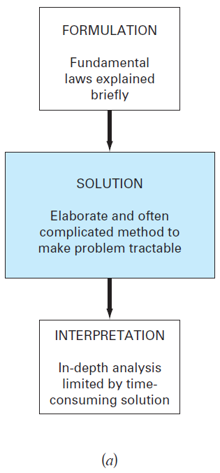
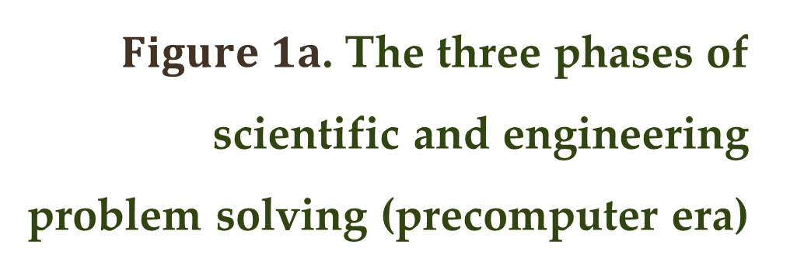
During the pre-computer era, significant amounts of energy were expended on the solution technique itself, rather than on problem definition and interpretation.
$Figure 1a$. The three phases of scientific and engineering problem solving (precomputer era)

Slide 13
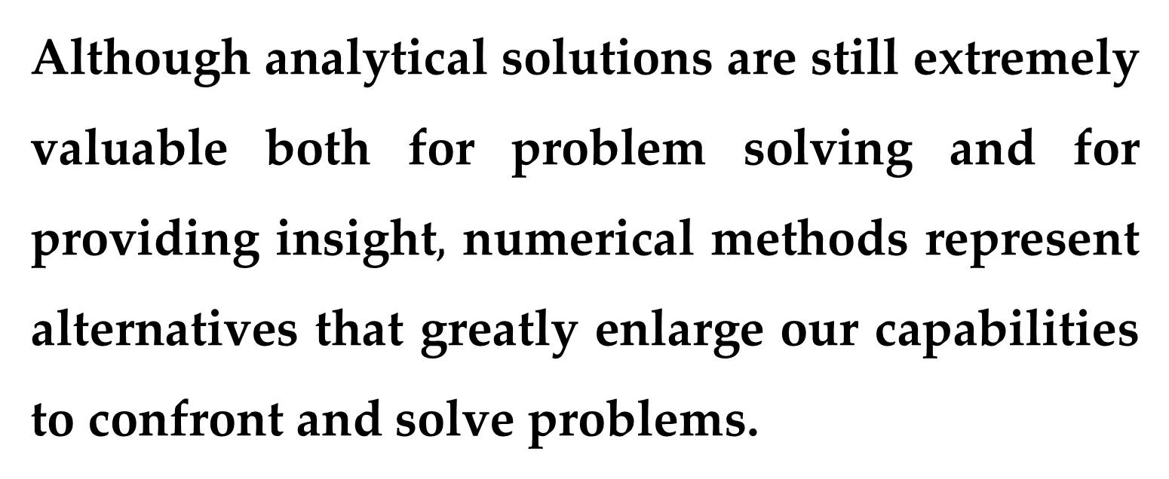
Today, computers and numerical methods provide an alternative for such complicated calculations.
Although analytical solutions are still extremely valuable both for problem solving and for providing insight$,$ numerical methods represent alternatives that greatly enlarge our capabilities to confront and solve problems.

Slide 14
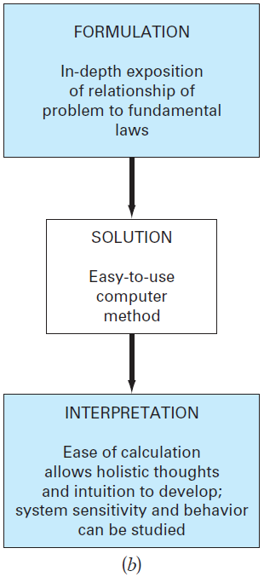
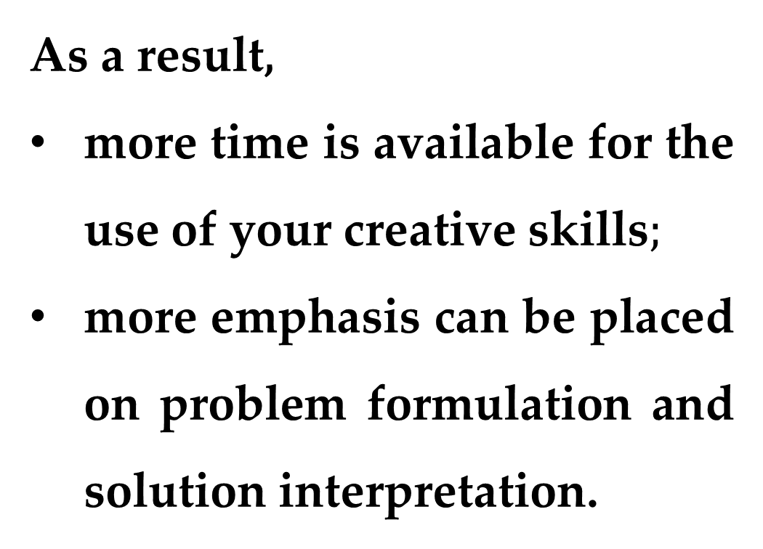
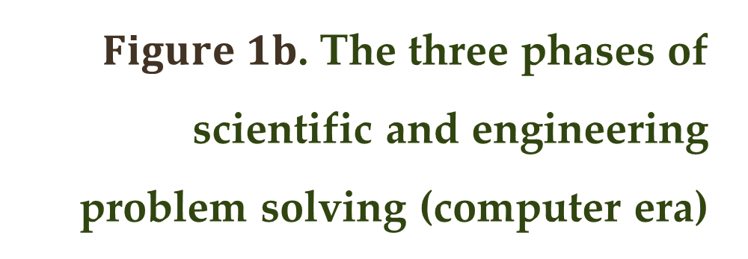
As a result,
more time is available for the use of your creative skills$;$
more emphasis can be placed on problem formulation and solution interpretation.
$Figure 1b$. The three phases of scientific and engineering problem solving (computer era)

Slide 15
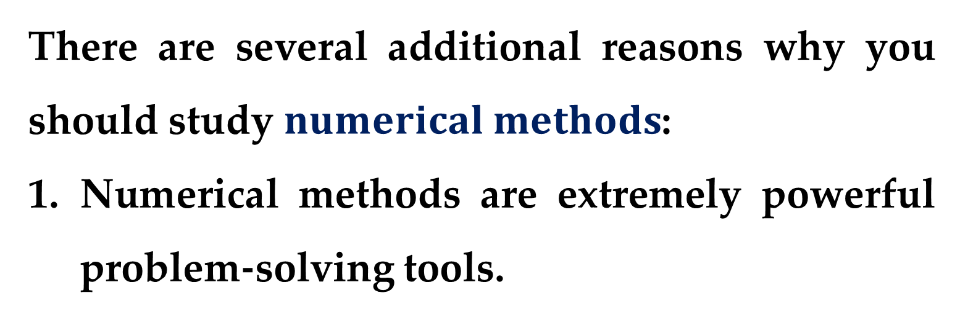
There are several additional reasons why you should study $numerical methods$:
Numerical methods are extremely powerful problem-solving tools.
They are capable of handling large systems of equations, nonlinearities, and complicated geometries that are not uncommon in practice and that are often impossible to solve analytically.

Slide 16
During your careers, you may often have occasion to use commercially available computer programs that involve numerical methods.
The intelligent and successful use of these programs is often predicated on knowledge of the basic theory underlying the methods.

Slide 17
Many problems cannot be approached using prepackaged (canned) programs.
If you are conversant with numerical methods and are adept at computer programming, you can design your own programs to solve problems without having to purchase expensive software.

Slide 18
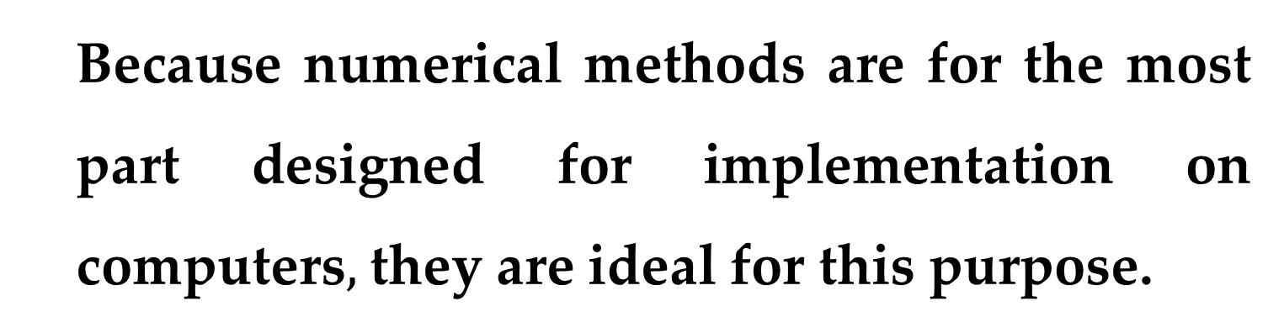
Numerical methods are an efficient vehicle for learning to use computers.
It is well known that an effective way to learn programming is to actually write computer programs.
Because numerical methods are for the most part designed for implementation on computers$,$ they are ideal for this purpose.

Slide 19
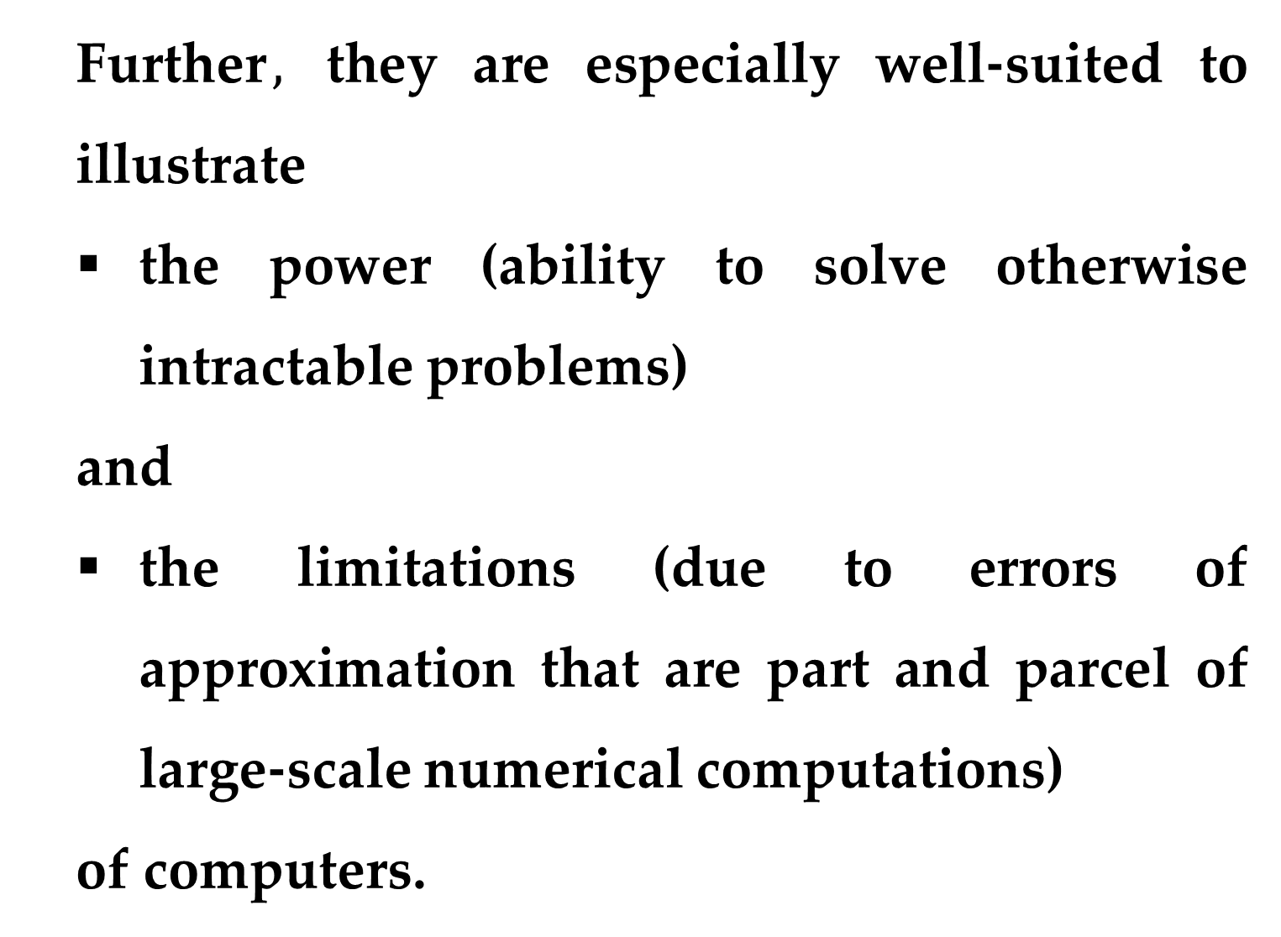
Further$,$ they are especially well-suited to illustrate
the power (ability to solve otherwise intractable problems)
and
the limitations (due to errors of approximation that are part and parcel of large-scale numerical computations)
of computers.

Slide 20
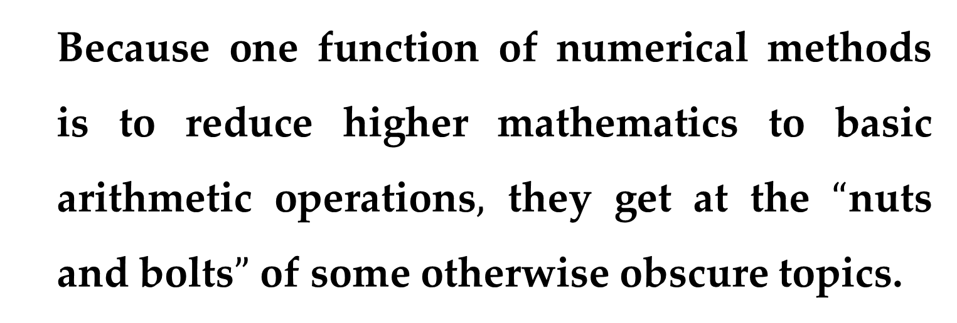
Numerical methods provide a vehicle for you to reinforce your understanding of mathematics.
Because one function of numerical methods is to reduce higher mathematics to basic arithmetic operations$,$ they get at the $“$nuts and bolts$”$ of some otherwise obscure topics.

Slide 21
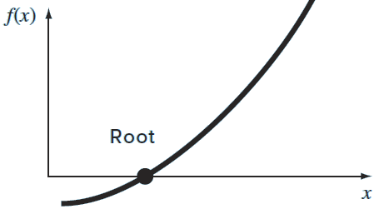
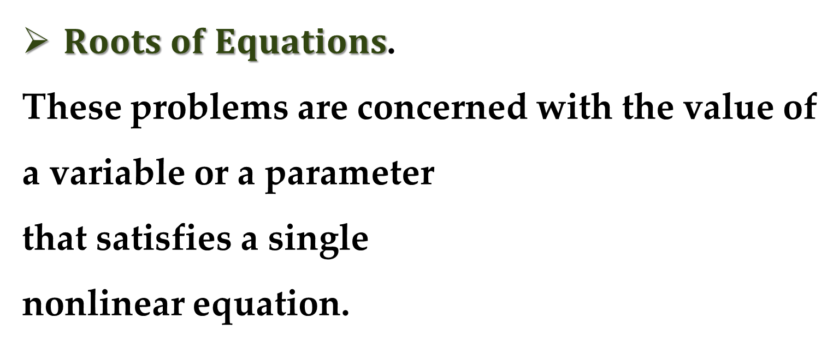
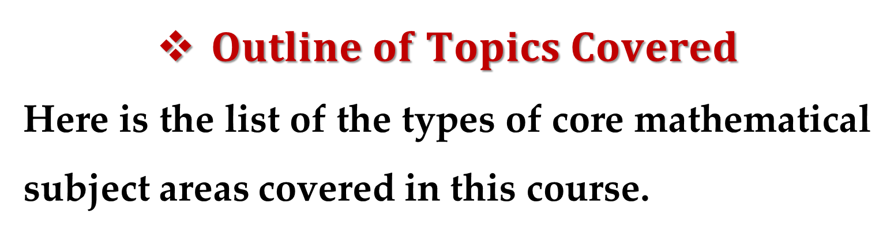
$Outline of Topics Covered$
Here is the list of the types of core mathematical subject areas covered in this course.
$Roots of Equations$.
These problems are concerned with the value of
a variable or a parameter
that satisfies a single
nonlinear equation.

Slide 22
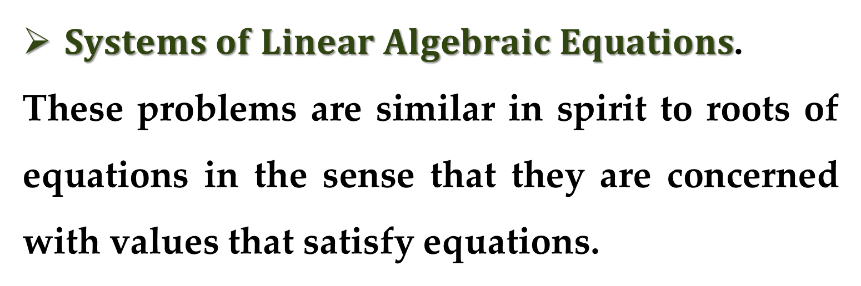
These problems are especially valuable in engineering design contexts where it is often impossible to explicitly solve design equations for parameters.
$Systems of Linear Algebraic Equations$.
These problems are similar in spirit to roots of equations in the sense that they are concerned with values that satisfy equations.

Slide 23
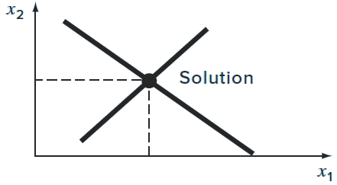
However, in contrast to satisfying a single equation, a set of values is sought that simultaneously satisfies a set of linear algebraic equations.
Such equations arise in a variety of problem contexts and in all disciplines of engineering.

Slide 24
In particular, they originate in the mathematical modeling of large systems of interconnected elements such as structures, electric circuits, and fluid networks.
However, they are also encountered in other areas of numerical methods such as curve fitting and differential equations.

Slide 25
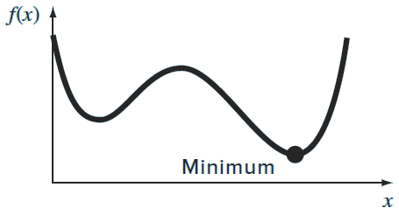
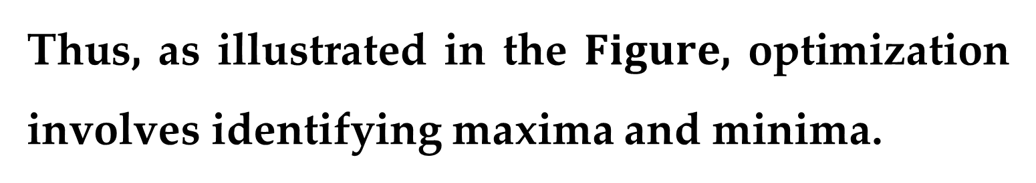
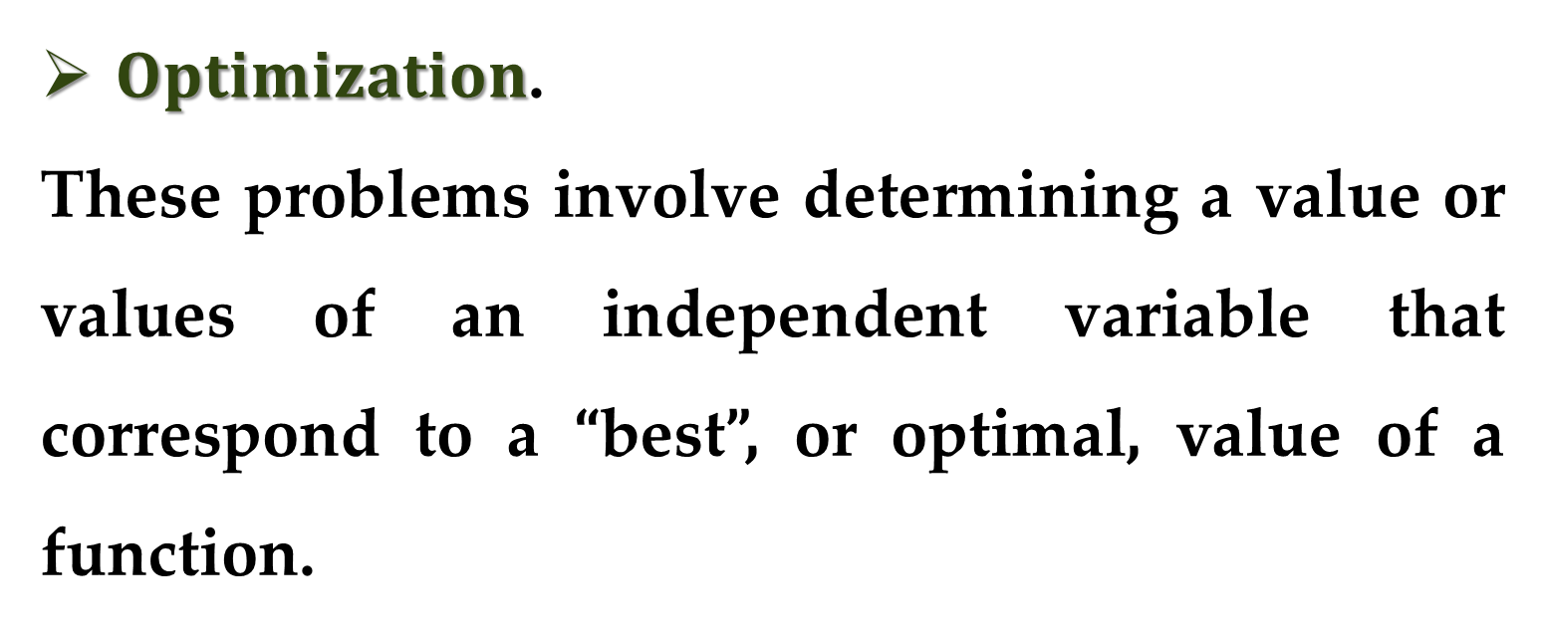
$Optimization$.
These problems involve determining a value or values of an independent variable that correspond to a “best”, or optimal, value of a function.
Thus, as illustrated in the $Figure$, optimization involves identifying maxima and minima.

Slide 26
Such problems occur routinely in engineering design contexts.
They also arise in a number of other numerical methods.
We address both single- and multi-variable unconstrained optimization.
We also describe constrained optimization with particular emphasis on linear programming.

Slide 27
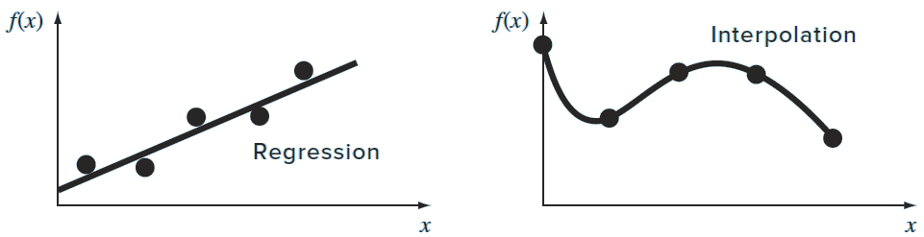
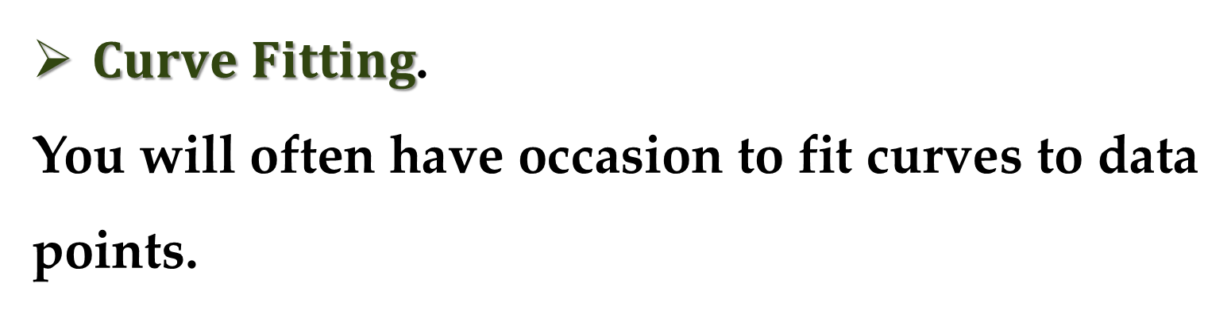
$Curve Fitting$.
You will often have occasion to fit curves to data points.
The techniques developed for this purpose can be divided into two general categories:
regression and interpolation.

Slide 28
Regression is employed where there is a significant degree of error associated with the data.
Experimental results are often of this kind.
For these situations, the strategy is to derive a single curve that represents the general trend of the data without necessarily matching any individual points.

Slide 29
In contrast, interpolation is used where the objective is to determine intermediate values between relatively error-free data points.
Such is usually the case for tabulated information.
For these situations, the strategy is to fit a curve directly through the data points and use the curve to predict the intermediate values.

Slide 30
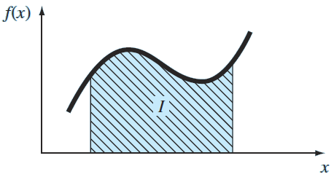
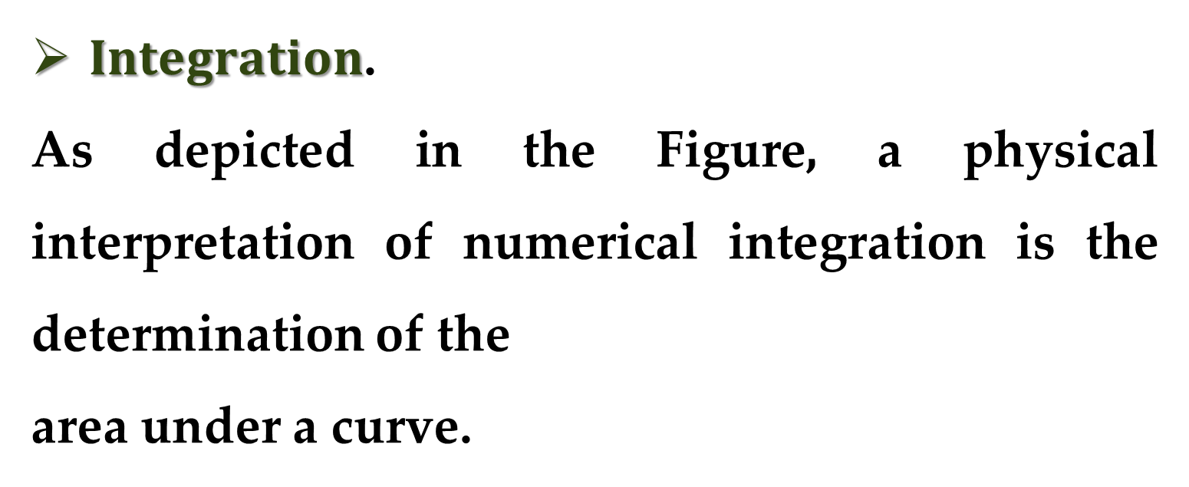
Here is the list of the types of auxiliary mathematical subject areas.
$Integration$.
As depicted in the Figure, a physical interpretation of numerical integration is the determination of the
area under a curve.

Slide 31
Integration has many applications in engineering practice, ranging from the determination of the centroids of oddly shaped objects to the calculation of total quantities based on sets of discrete measurements.
In addition, numerical integration formulas play an important role in the solution of differential equations.

Slide 32
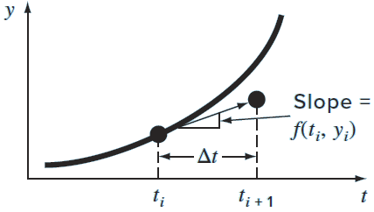

$Ordinary Differential Equations$.
Ordinary differential equations are of great significance in engineering practice.
This is because many physical laws are couched in terms of the rate of change of a quantity rather than the magnitude
of the quantity itself.

Slide 33
Examples range from population-forecasting models (rate of change of population) to the acceleration of a falling body (rate of change of velocity).
Two types of problems are considered:
initial-value and boundary-value problems.
In addition, the computation of eigenvalues is considered.

Slide 34
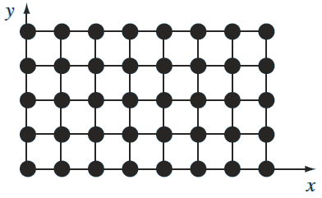
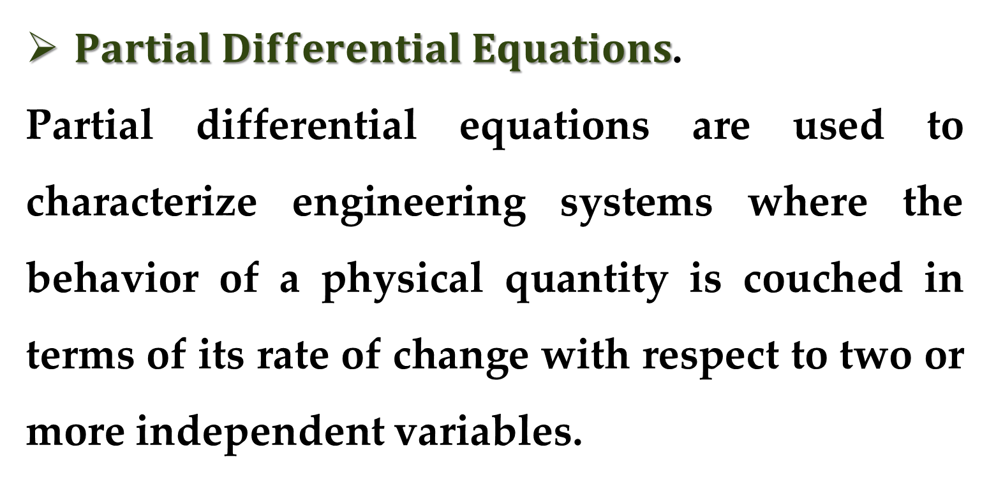
$Partial Differential Equations$.
Partial differential equations are used to characterize engineering systems where the behavior of a physical quantity is couched in terms of its rate of change with respect to two or more independent variables.

Slide 35
Examples include the steady-state distribution of temperature on a heated plate (two spatial dimensions) or the time-variable temperature of a heated rod (time and one spatial dimension).
Two fundamentally different approaches are employed to solve partial differential equations numerically:
finite-difference methods that approximate the solution in a pointwise fashion;
finite-element methods, which use a piecewise approach.

Slide 36
Introduction:
Mathematical Modeling

Slide 37
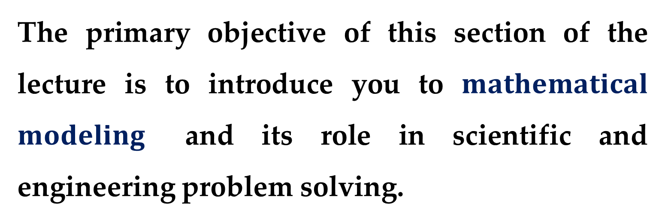
The primary objective of this section of the lecture is to introduce you to $mathematical$ $modeling$ and its role in scientific and engineering problem solving.
We will also illustrate how numerical methods figure in the process.

Slide 38
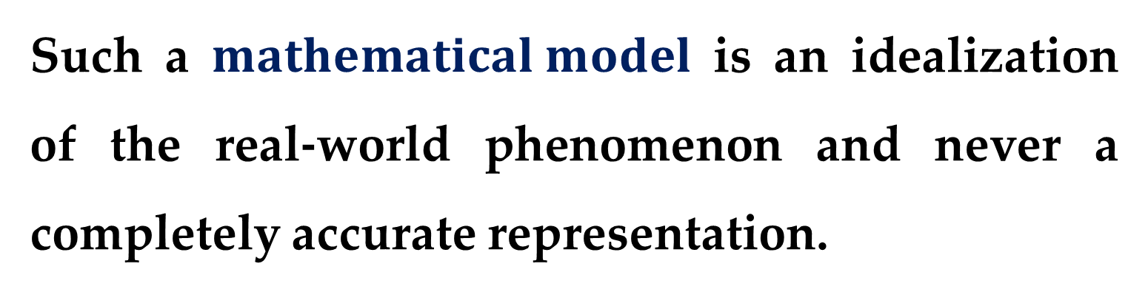
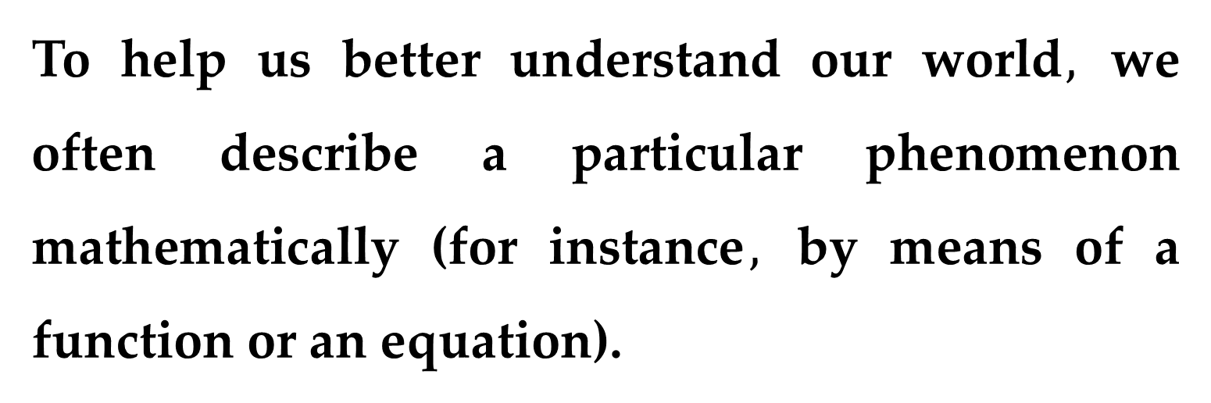
To help us better understand our world$,$ we often describe a particular phenomenon mathematically (for instance$,$ by means of a function or an equation).
Such a $mathematical model$ is an idealization of the real-world phenomenon and never a completely accurate representation.

Slide 39
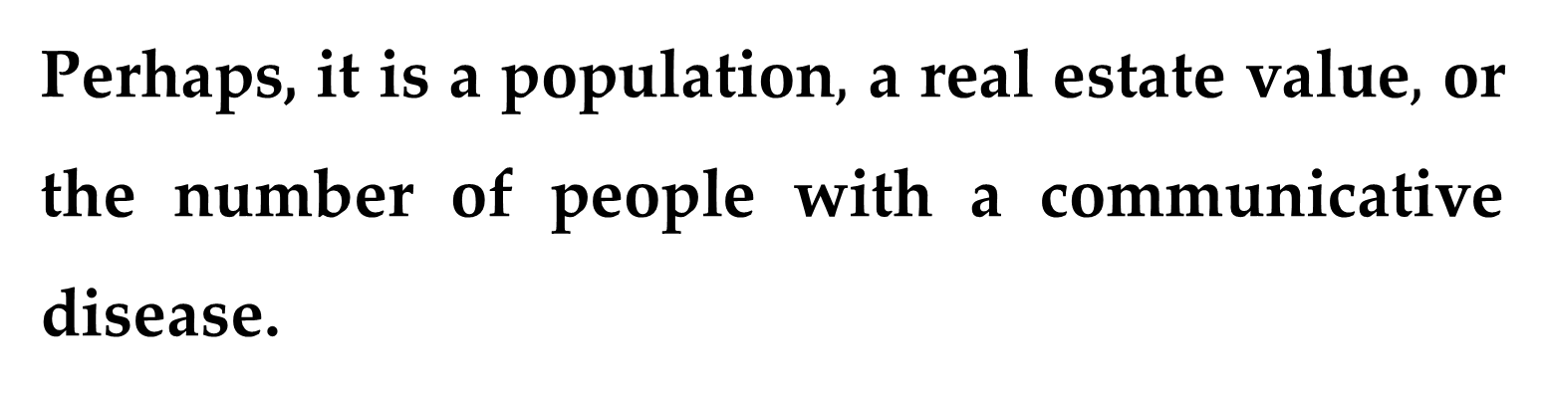
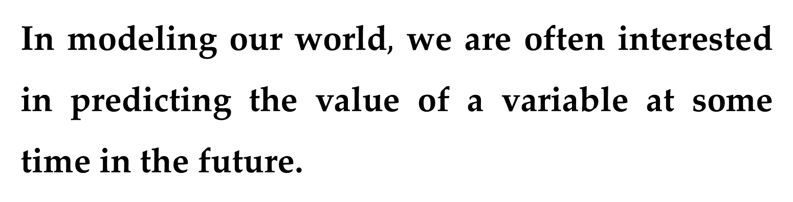
In modeling our world$,$ we are often interested in predicting the value of a variable at some time in the future.
Perhaps, it is a population$,$ a real estate value$,$ or the number of people with a communicative disease.
Often a mathematical model can help us understand a behavior better or aid us in planning for the future.

Slide 40
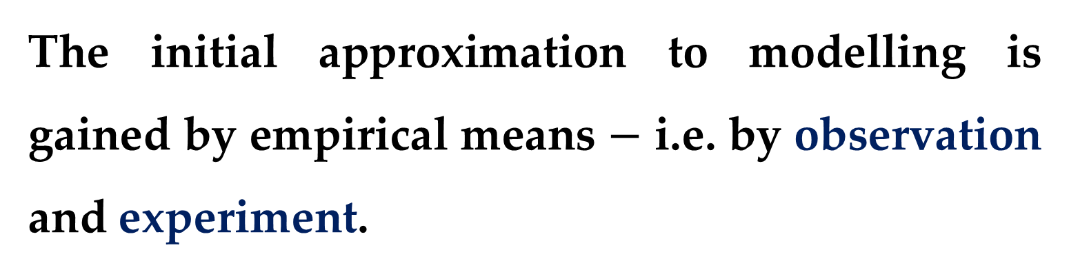
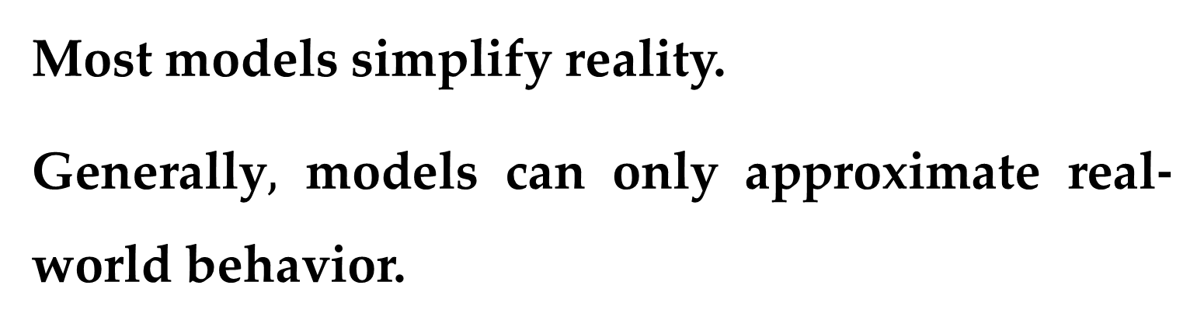
Most models simplify reality.
Generally$,$ models can only approximate real-world behavior.
The initial approximation to modelling is gained by empirical means $−$ i.e. by observation and experiment.
However, while such empirically derived information is essential, it is only half the story.

Slide 41
Over years and years of observation and experiment, scientists and engineers have noticed that certain aspects of their empirical studies occur repeatedly.
Such general behavior can then be expressed as fundamental laws.

Slide 42
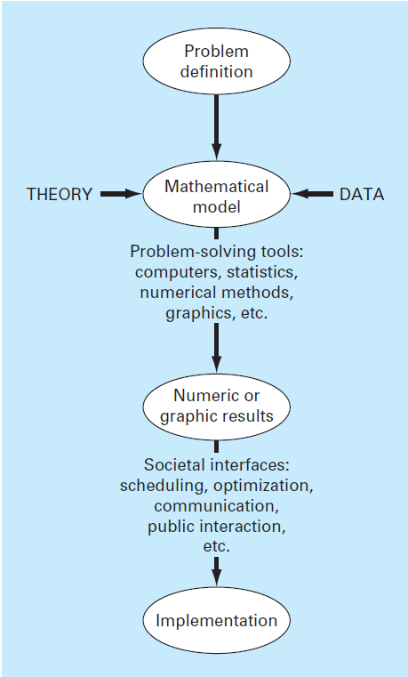
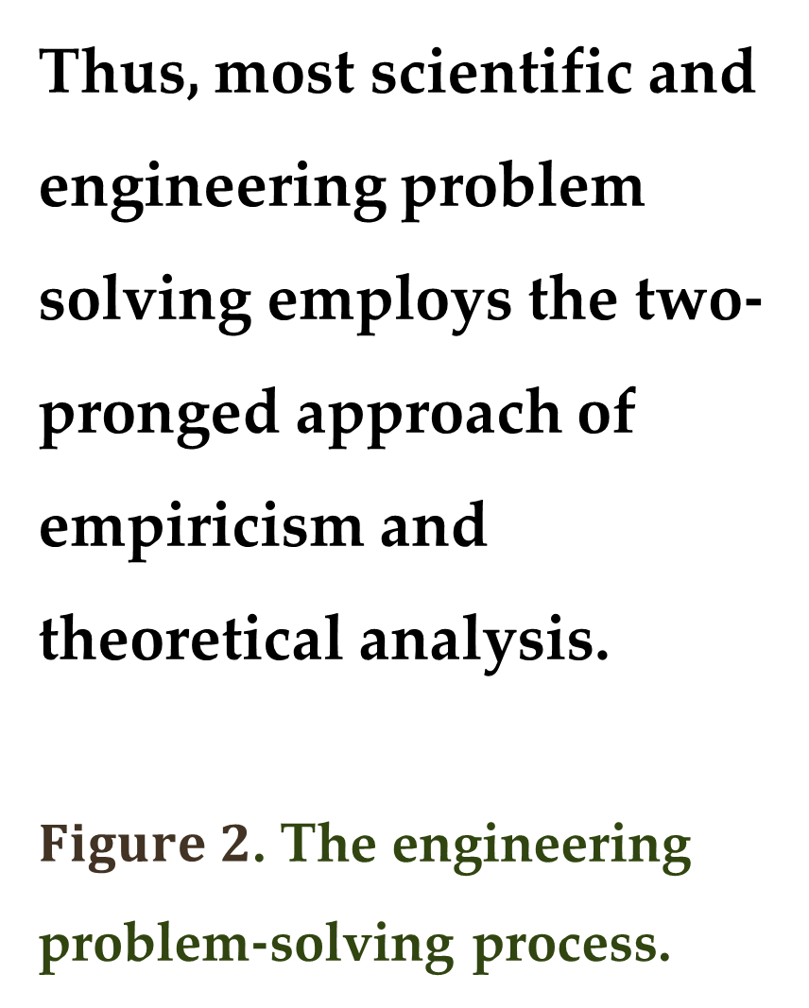
Thus, most scientific and engineering problem solving employs the two-pronged approach of empiricism and theoretical analysis.
$Figure 2$. The engineering problem-solving process.

Slide 43
Introduction:
A Simple Mathematical Model

Slide 44
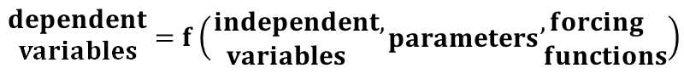
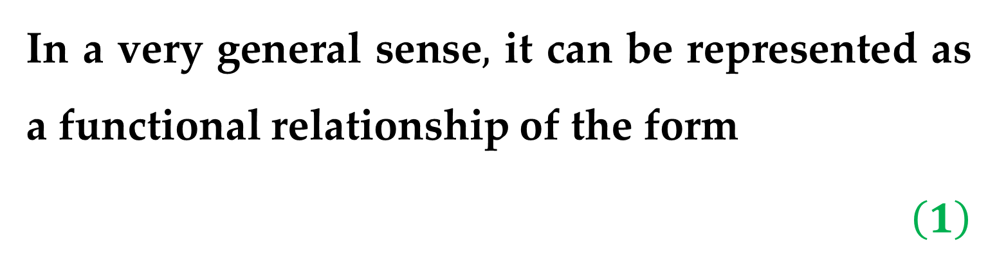

$$Definition$$
A $mathematical model$ can be broadly defined as a formulation or equation that expresses the essential features of a system or process in mathematical terms.
In a very general sense$,$ it can be represented as a functional relationship of the form
$$\left(1\right)$$

Slide 45




the $dependent variable$ is a characteristic that usually reflects the behavior or state of the system$;$
the $independent variables$ are usually dimensions$,$ such as time and space$;$
the $parameters$ are reflective of the system$’$s properties or composition$;$
the $forcing functions$ are external influences acting upon the system.

Slide 46


The actual mathematical expression of Eq. $\left(1\right)$ can range from an algebraic relationship to large sets of differential and integral equations.
$Illustrative Example$.
On the basis of his observations, Isaac Newton formulated his second law of motion, which states that the time rate of change of momentum of a body is equal to the resultant force acting on it.

Slide 47


The mathematical expression$,$ or model$,$ of the second law is the well-known equation
$F=m∙a$ $\left(2\right)$
Here
$F$ the net force acting on the body ($N,$ or $kg∙m/s^{2}$)$;$
$m$ the mass of the object ($kg$)$;$
$a$ its acceleration ($m/s^{2}$).

Slide 48


The second law can be recast in the format of Eq. $\left(1\right)$ by merely dividing both sides by $m$ to give
$a=\frac{F}{m}$ $\left(3\right)$
$a$ is the $dependent variable$ reflecting the system$’$s behavior$;$
$F$ is the $forcing function;$
$m$ is a $parameter$ representing a property of the system.

Slide 49

Note that for this simple case there is no independent variable because we are not yet predicting how acceleration varies in time or space.
Equation $\left(3\right)$ has several characteristics that are typical of mathematical models of the physical world (which are summarized below).

Slide 50
It describes a natural process or system in mathematical terms.
It represents an idealization and simplification of reality.
(i.e. the model ignores negligible details of the natural process and focuses on its essential manifestations)

Slide 51

$$Example (of the 2nd characteristic)$$
The second law does not include the effects of relativity that are of minimal importance when applied to objects and forces that interact on or about the earth’s surface at velocities and on scales visible to humans.

Slide 52

It yields reproducible results and, consequently, can be used for predictive purposes.
$$Example (of the 3rd characteristic)$$
If the force on an object and the mass of the object are known, Eq. $\left(3\right)$ can be used to compute acceleration.

Slide 53

Because of its simple algebraic form, the solution of Eq. $\left(2\right)$ can be obtained easily.
However, other mathematical models of physical phenomena may be much more complex, and either cannot be solved exactly or require more sophisticated mathematical techniques than simple algebra for their solution.

Slide 54



To illustrate a more complex model of this kind$,$
Newton$’$s second law can be used to determine the terminal velocity of a free-falling body near the earth$’$s surface.
$$Example$$
Our falling body will be a parachutist.
$Figure 2$. Schematic diagram of the forces acting on a falling parachutist.

Slide 55


$Example$. $(continued)$
A model for this case can be derived by expressing the acceleration as the time rate of change of the velocity ($dv/dt$) and substituting it into Eq. $\left(3\right)$ to yield
$dv/dt=F/m$ $\left(4\right)$
Here $v$ is velocity ($m/s$) and $t$ is time ($s$).

Slide 56


$Example$. $(continued)$
According to Eq. $\left(4\right),$ the mass multiplied by the rate of change of the velocity is equal to the net force acting on the body.
If the net force is positive$,$ the object will accelerate.
If it is negative$,$ the object will decelerate.
If it is zero$,$ the object$’$s velocity will remain at a constant level.

Slide 57


$Example$. $(continued)$
Next$,$ we will try to express the net force in terms of measurable variables and parameters.
For a body falling within the vicinity of the earth$,$ the net force is composed of two opposing forces:
the downward pull of gravity $F_{D};$
the upward force of air resistance $F_{U}$.

Slide 58



$Example$. $(continued)$
This net force is expressed as follows:
$F=F_{D}+F_{U}$ $\left(5\right)$
If the downward force is assigned a positive sign$,$ the second law can be used to formulate the force due to gravity$,$ as
$F_{D}=m∙g$ $\left(6\right)$
Here $g$ is the gravitational constant, or the acceleration due to gravity ($≈9.8 m/s^{2}$).

Slide 59


$$Example\text{. }(continued)$$
Air resistance can be formulated in a variety of ways:
a simple approach is to assume that it is linearly proportional to velocity and acts in an upward direction$,$ as in
$F_{U}=−c∙v$ $\left(7\right)$
Here $c$ is a proportionality constant called the drag coefficient ($kg/s$).

Slide 60



$$Example\text{. }(continued)$$
Thus$,$ the greater the fall velocity$,$ the greater the upward force due to air resistance.
The parameter $c$ accounts for properties of the falling object, such as shape or surface roughness$,$ that affect air resistance.
For the present case$,$ $c$ might be a function of the type of jumpsuit or the orientation used by the parachutist during free-fall.

Slide 61


$$Example\text{. }(continued)$$
The net force is the difference between the downward and upward force.
Therefore$,$ Eq. $\left(4\right)$ through $\left(7\right)$ can be combined to yield
$\frac{dv}{dt}=\frac{m∙g−c∙v}{m}$ $\left(8\right)$
Or simplifying the right side
$\frac{dv}{dt}=g−\frac{c}{m}v$ $\left(9\right)$

Slide 62


$$Example\text{. }(continued)$$
Equation $\left(9\right)$ is a model that relates the acceleration of a falling object to the forces acting on it.
It is a differential equation because it is written in terms of the differential rate of change ($dv/dt$) of the variable that we are interested in predicting.

Slide 63

$$Example\text{. }(continued)$$
However, in contrast to the solution of Newton’s second law in Eq. $\left(3\right)$, the exact solution of Eq. $\left(9\right)$ for the velocity of the falling parachutist cannot be obtained using simple algebraic manipulation.
Rather, more advanced techniques (such as those of calculus) must be applied to obtain an exact or analytical solution.

Slide 64


$$Example\text{. }(continued)$$
For instance, if the parachutist is initially at rest ($v=0$ at $t=0$), calculus can be used to solve Eq. $\left(9\right)$ for
$v\left(t\right)=\frac{gm}{c}\left(1−e^{−\left(c/m\right)t}\right)$ $\left(10\right)$
Note that Eq. $\left(10\right)$ is cast in the general form of Eq. $\left(1\right)$, where $v(t)$ is the dependent variable$,$ $t$ is the independent variable$,$ $c$ and $m$ are parameters$,$ and $g$ is the forcing function.

Slide 65


Example 1. Analytical Solution to the Falling Parachutist Problem
A parachutist of mass $68.1$ $kg$ jumps out of a stationary hot air balloon.
Use Eq. $\left(10\right)$ to compute velocity prior to opening the chute.
The drag coefficient is equal to $12.5$ $kg/s$.

Slide 66


Solution
Inserting the parameters into Eq. $\left(10\right)$ yields
$$v\left(t\right)=9.8\frac{68.1}{12.5}\left(1−e^{−\left(12.5/68.1\right)t}\right)=$$
$$=53.9\left(1−e^{−0.18355t}\right)$$
This relation can be used to compute the velocity at different points of time (for instance$,$ at $t=0,2,4,6,8,10,12,…$).

Slide 67




According to the model, the parachutist accelerates rapidly. ($Figure 4$)
A velocity of $44.87$ $m/s$ is attained after $10$ $s$.
Note also that after a sufficiently long time$,$ a constant velocity$,$ called the $terminal velocity$, of $53.39 m/s$ is reached.

Slide 68

Solution. $\left(continued\right)$
This velocity is constant because, eventually, the force of gravity will be in balance with the air resistance.
Thus, the net force will be zero and acceleration will eventually cease.

Slide 69

Eq. $\left(10\right)$ is called $analytical$, or $exact$, solution because it exactly satisfies the original differential equation.
Unfortunately, there are many mathematical models that cannot be solved exactly.
In many of these cases, the only alternative is to develop a numerical solution that approximates the exact solution.

Slide 70


$$Definition$$
$Numerical methods$ are those in which the mathematical problem is reformulated so it can be solved by arithmetic operations.
This can be illustrated for Newton$’$s second law by realizing that the time rate of change of velocity can be approximated by ($Figure 5$):
$\frac{dv}{dt}≅\frac{∆v}{∆t}=\frac{v\left(t_{i+1}\right)−v\left(t_{i}\right)}{t_{i+1}−t_{i}}$ $\left(11\right)$

Slide 71


$Figure 5$. The use of a finite difference to approximate the first derivative of $v$ with respect to $t$.

Slide 72


Here:
$∆v$ and $∆t$ are differences in velocity and time, respectively, computed over finite intervals$;$
$v(t_{i})$ is the velocity at an initial time $t_{i};$
$v(t_{i+1})$ is the velocity at some later time $t_{i+1}$.
Remember from calculus that
$$\frac{dv}{dt}=\lim_{∆t→0}{\frac{∆v}{∆t}}$$

Slide 73



$$Definition$$
Eq. $\left(11\right)$ is called a $finite divided difference$ approximation of the derivative at time $t_{i}$.
It can be substituted into Eq. $\left(9\right)$ to give
$$\frac{v\left(t_{i+1}\right)−v\left(t_{i}\right)}{t_{i+1}−t_{i}}=g−\frac{c}{m}v(t_{i})$$
This equation can then be rearranged to yield
$v\left(t_{i+1}\right)=v\left(t_{i}\right)+\left[g−\frac{c}{m}v\left(t_{i}\right)\right]\left(t_{i+1}−t_{i}\right)$ $\left(12\right)$

Slide 74


Thus, the differential equation has been transformed into an equation that can be used to determine the velocity algebraically at $t_{i+1}$ using the slope and previous values of $v$ and $t$.
Notice that the term in brackets
$$\left[g−\frac{c}{m}v\left(t_{i}\right)\right]$$
is the right-hand side of the differential equation itself.

Slide 75



If you are given an initial value for velocity at some time $t_{i},$ you can easily compute velocity at a later time $t_{i+1}$.
This new value of velocity at $t_{i+1}$ can in turn be employed to extend the computation to velocity at $t_{i+2}$ and so on.
Thus$,$ at any time along the way
“new_value = old_value + slope × step_size"

Slide 76


Example 2. Numerical Solution to the Falling Parachutist Problem
Perform the same computation as in $Example 1$ but use Eq. $\left(12\right)$ to compute the velocity.
Employ a step size of $2$ for the calculation.
Solution
At the start of the computation ($t_{i}=0$), the velocity of the parachutist is zero.

Slide 77


Solution. $\left(continued\right)$
Using this information and the parameter values from $Example 1$, Eq. $\left(12\right)$ can be used to compute velocity at different points of time (for instance$,$ at $t=0,2,4,6,8,10,12,…$).
The results are plotted in $Figure 6$ along with the exact solution, from which it can be seen that the numerical method captures the essential features of the exact solution.

Slide 78


$Figure 6$. Comparison of the numerical and analytical solutions for the falling parachutist problem.

Slide 79
However, because we have employed straight-line segments to approximate a continuously curving function, there is some discrepancy between the two results.
One way to minimize such discrepancies is to use a smaller step size.
Using hand calculations, the effort associated with using smaller and smaller step sizes would make such numerical solutions impractical.

Slide 80
However, with the aid of the computer, large numbers of calculations can be performed easily.
Thus, you can accurately model the velocity of the falling parachutist without having to solve the differential equation exactly.

Slide 81

$$Trade−Offs$$
As in the previous example, a computational price must be paid for a more accurate numerical result.
Each halving of the step size to attain more accuracy leads to a doubling of the number of computations.
Thus, we see that there is a trade-off between accuracy and computational effort.

Slide 82
Such trade-offs figure prominently in numerical methods and constitute an important theme of numerical analysis.
Thank you for attention

Slide 83
text
text
text

